Slide 1

Auto-Marking System for Advanced IT Skill Final Exam Using Python Dataframe
Mohamed Ali N.M.A

Slide 2
Introduction
Auto-marking system is developed for the Staff members to evaluate the Advanced IT skills final exam automatically.
Inputs: Answer key of the final exam and students’ answer files
Output: The students’ answers files with marks.
Marking Rubric & matching ratio
The staff members can finish the marking for all the students with just one mouse click.
The system was written in the Python programming language to handle and process the data from the input files.

Slide 3
One mouse click is enough to finish marking a student answer file
auto_marking_v1.py

Slide 4
Advanced IT Skills Final Exam Paper

Slide 5
Why do we need a Program?
Marking is a Time consuming task
Paperless Examination

Slide 6
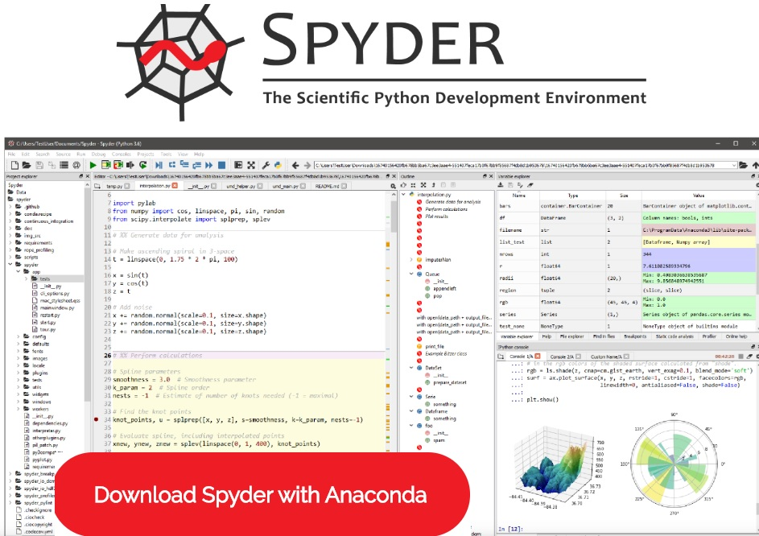
Spyder with Anaconda
Setting up an Environment
Spyder is an IDE
Anaconda – one of the Python distribution

Slide 7
Python Pandas Dataframe
Data frame is a two-dimensional data structure.
Data is aligned in a tabular fashion in rows and columns.
DataFrame consists of three principal components, the data, rows, and columns.

Slide 8
Auto-marking system I/O
Auto-marking system
Student Answer File
Student Answer File with marks
Answer Key

Slide 9
Student Answer File

Slide 10
Answer Key Preparation

Slide 11
Program Flow..
Step 1
Set Path for Answer Key and Student Answer file.
Step 2
Create Dataframes for Answer Key and Student Answer File
Step 3
Finding Matching ratio & Keep in the Dataframe
Step 4
Allocate marks based on matching ratio and marking rubrics. Keep in the Dataframe
Step 5
Writeback Dataframe with results in the Student answer file

Slide 12
Marking Rubric
Components | Marks
Matching Ratio =100 | 100%
Matching Ratio between 80 to 99 | 50% marks with functions exist in the answer
Function Exists in the answer | One Function | If exists 25%, otherwise 0%
 | Two Functions | Each function 12.5%, otherwise 0%
 | Three Functions | Three functions 25% Less than 3 functions 12.5% Otherwise 0%

Slide 13
Disadvantages

Slide 14
difflib.sequencematcher
difflib: This module provides classes and functions for comparing sequences.
Sequencematcher: This is a flexible class for comparing pairs of sequences of any type

Slide 15
Thank You for Listening
Mohamed Ali N.M.A

